Slide 1
What’s next for our club?
Upcoming events
Building a board
Survey results

Slide 2
Upcoming events
July 23: Student Send-off at the Hillsboro Hops Ron Tonkin Field, Hillsboro 12:15pm – Welcome our newest members of the Orange Family! 1:05pm – First pitch vs. Eugene Watch your email for details and to register.
Oct. 14: Football game watch and blood drive Old Market Pub, SW Portland 9:30am – 2:00pm – Red Cross blood drive TBA – Kickoff vs. Florida State
This fall, TBA: SU Career Services comes to Portland A visit by Roshni Lal, Ph.D., SU’s Career Services and Life Design Expert for Students & Alumni Details forthcoming.

Slide 3
From the May
alumni club survey…

Slide 4
Specific tasks we hope to fill in the near future…
}
Event coordinator
Sports coordinator
Communications/social media coordinator
Club chair or co-chairs
Can be the same person or different people.

Slide 5
More survey results to come…

Slide 6
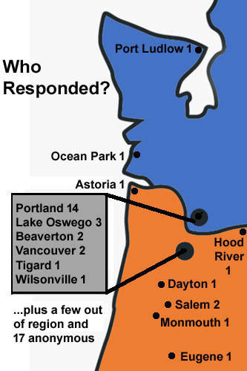
Club Survey Conducted May 5 – 16, 2023 53 respondents (4% return)

Slide 7
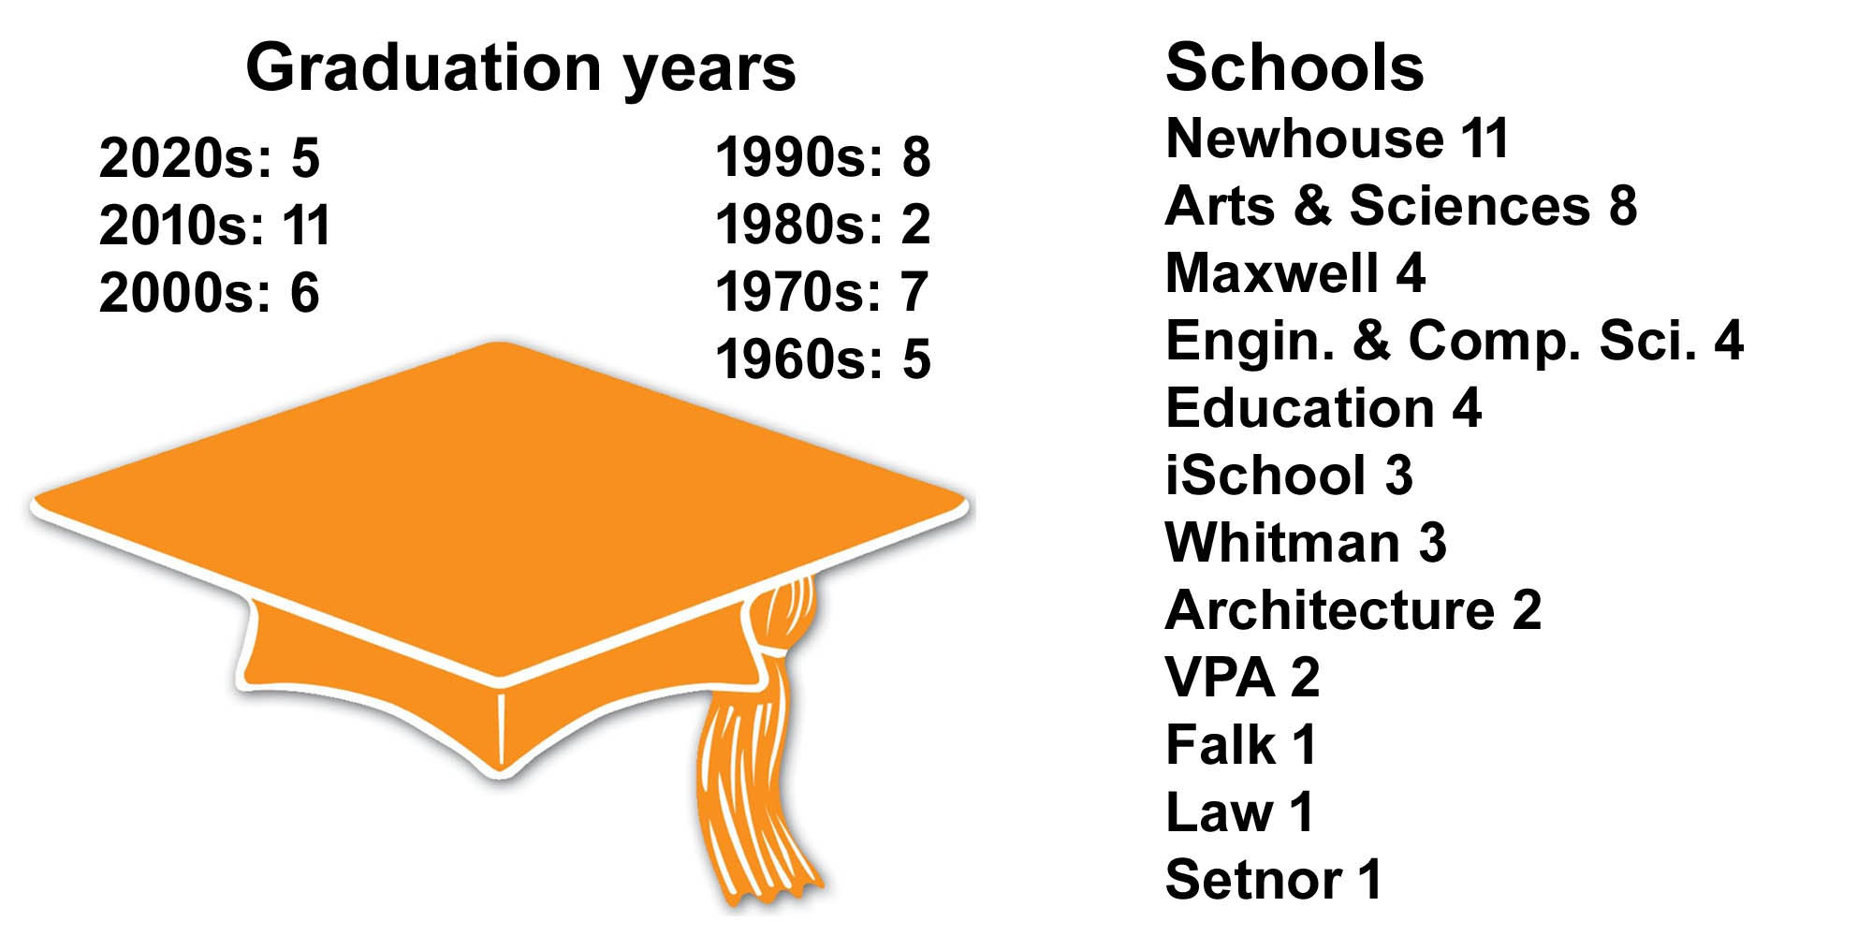

Slide 9
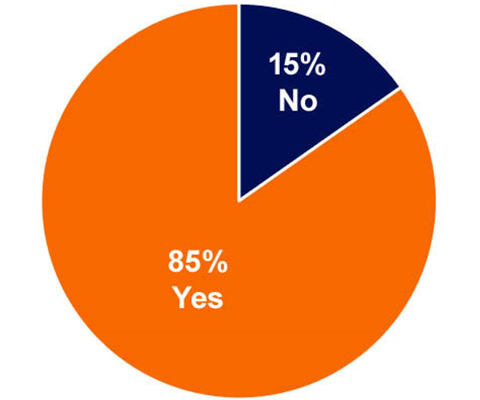
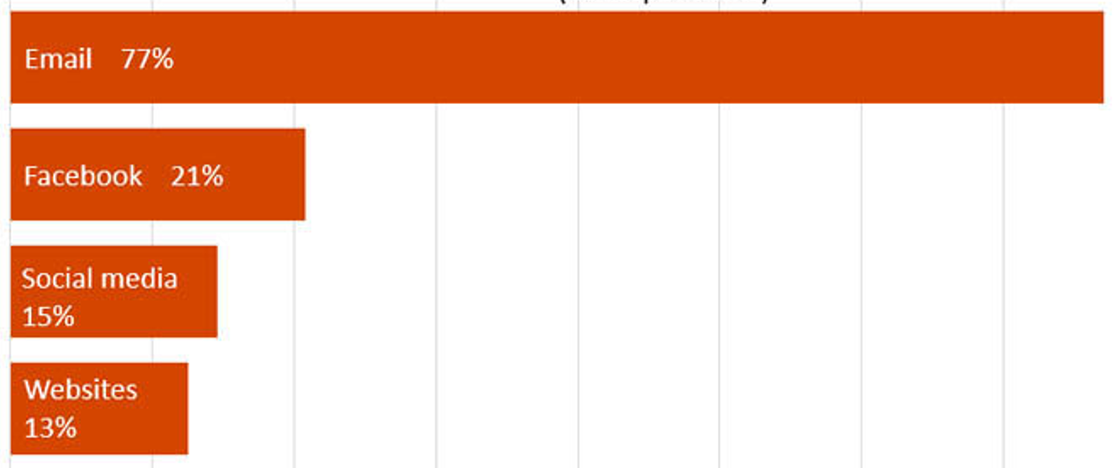
How to interpret the data…
Pie charts are used for questions with only one answer.
(Combined percentages equal 100.)
Bar graphs are used for questions where respondents can “choose all that apply.”
(Combined percentages can exceed 100.)

Slide 10
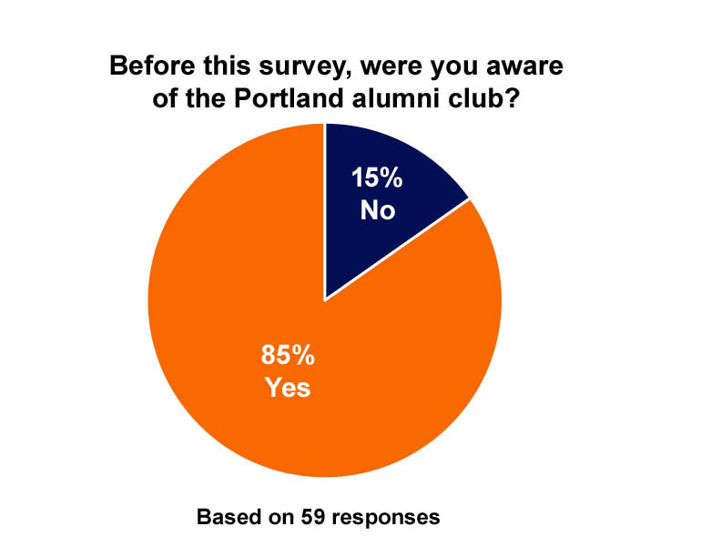

Slide 11
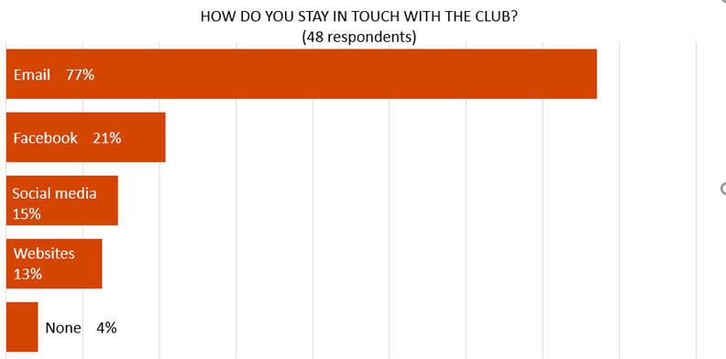

Slide 12
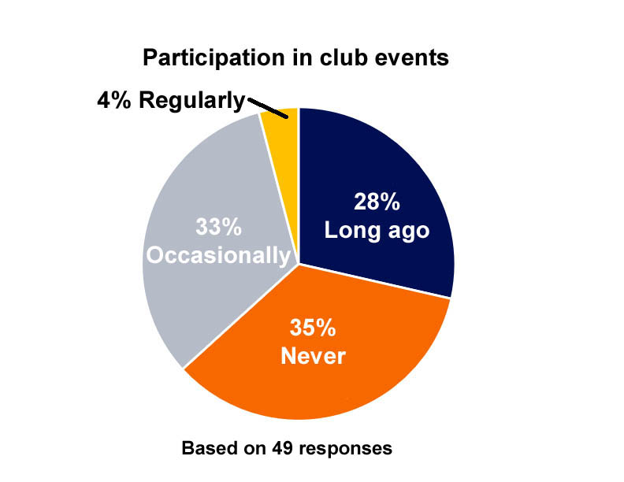

Slide 13
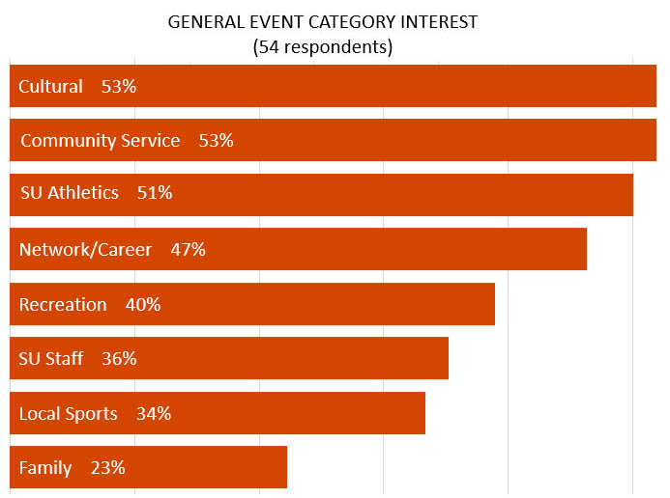

Slide 14
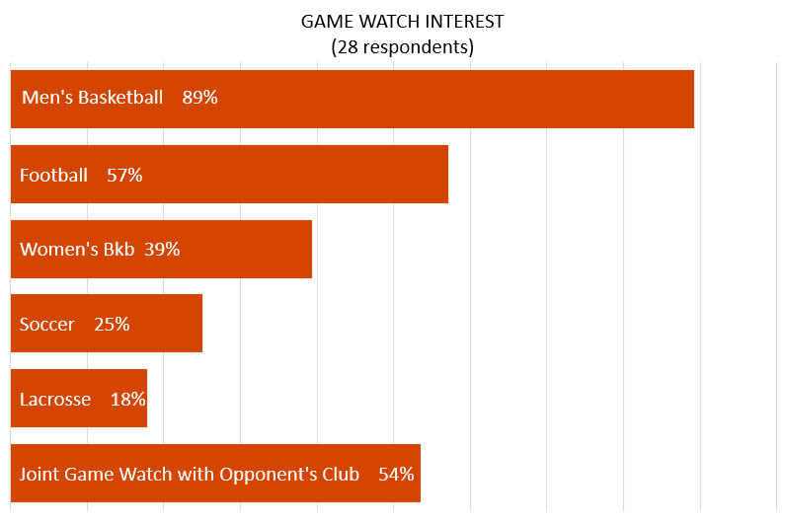
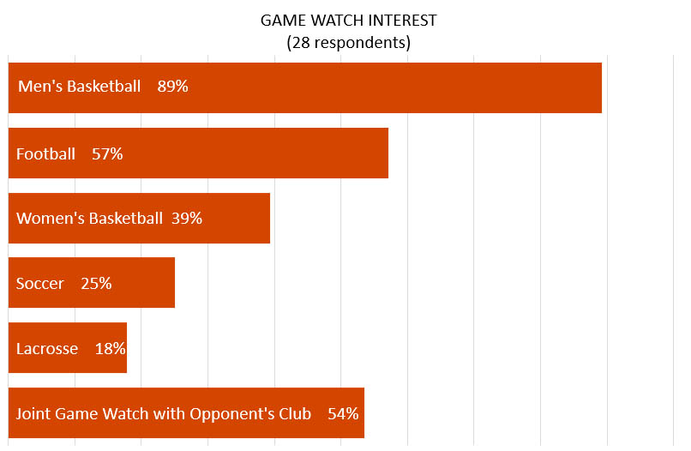

Slide 15
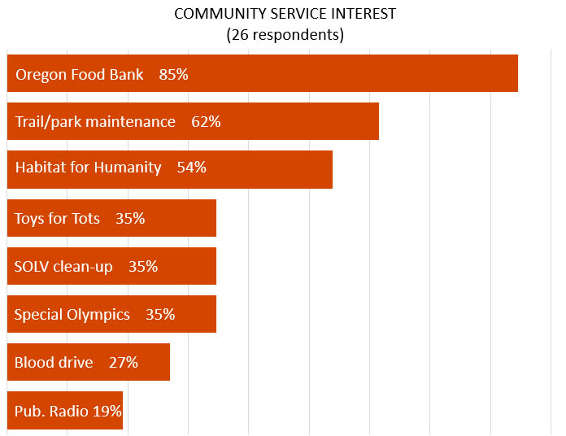

Slide 16
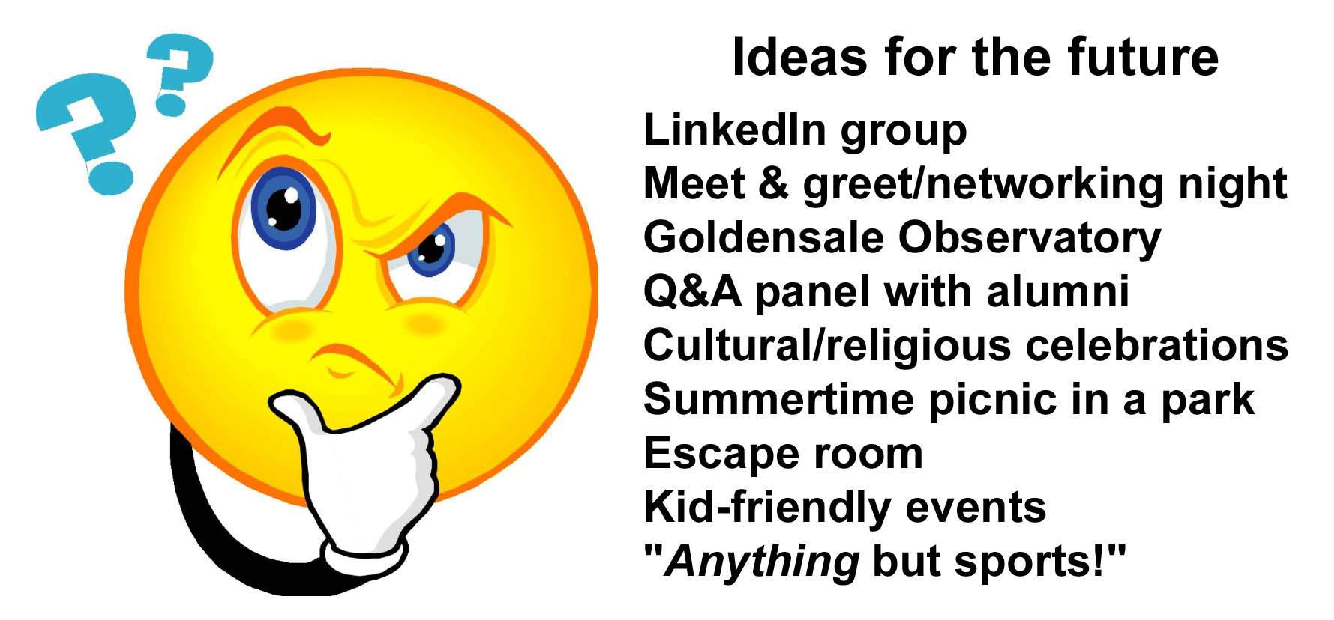

Slide 17
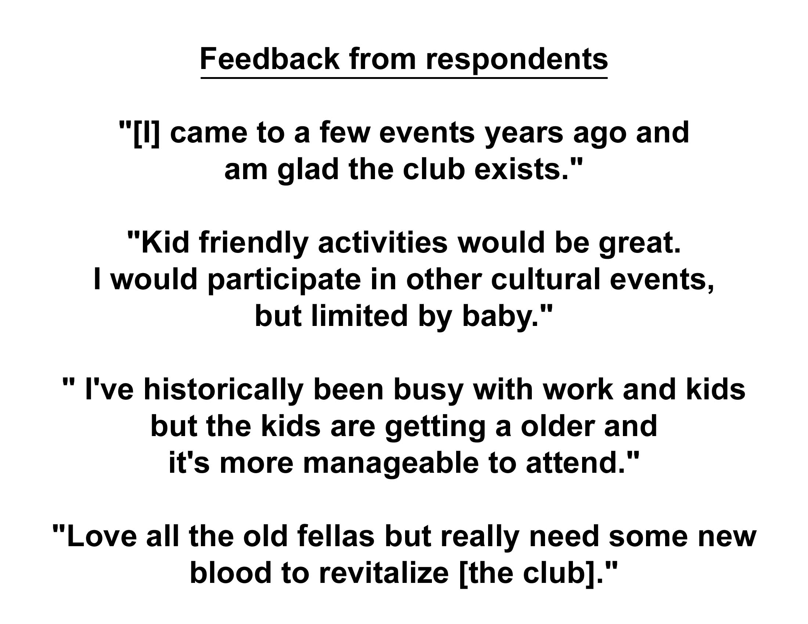

Slide 18
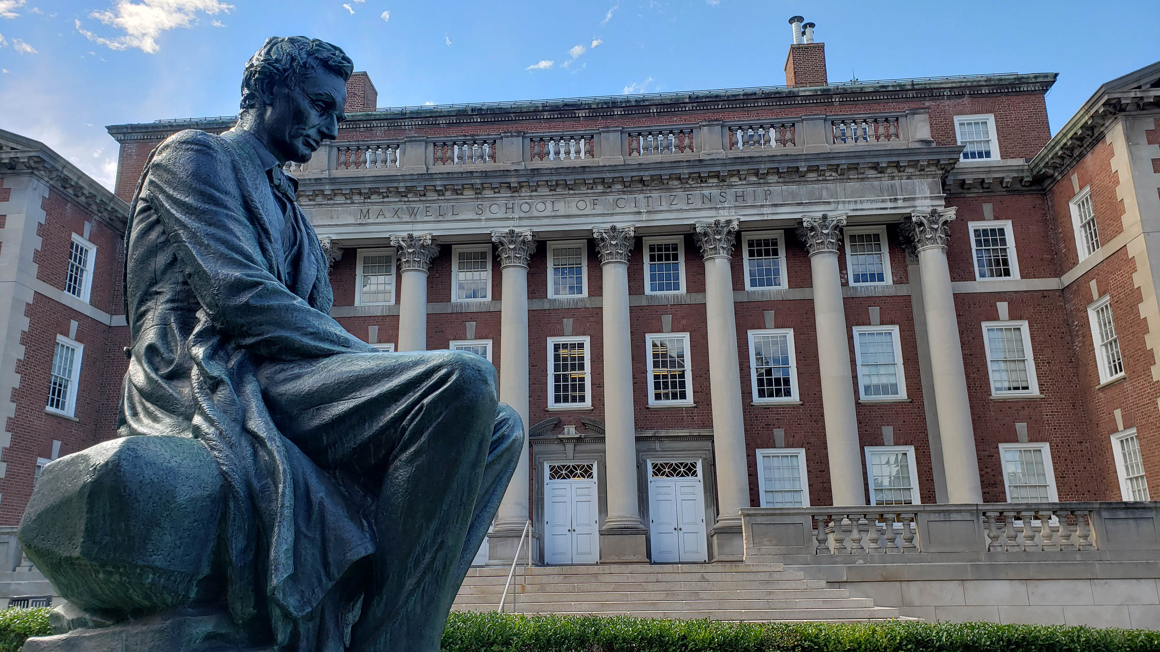
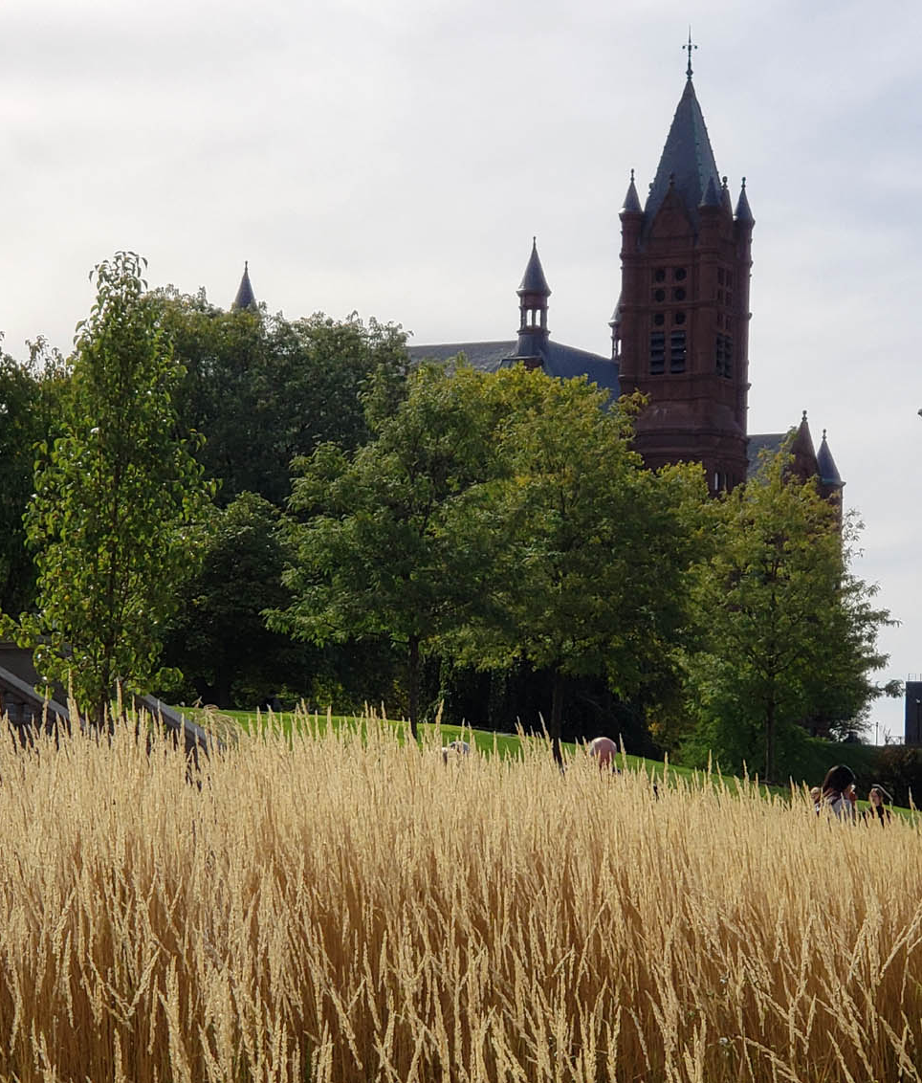
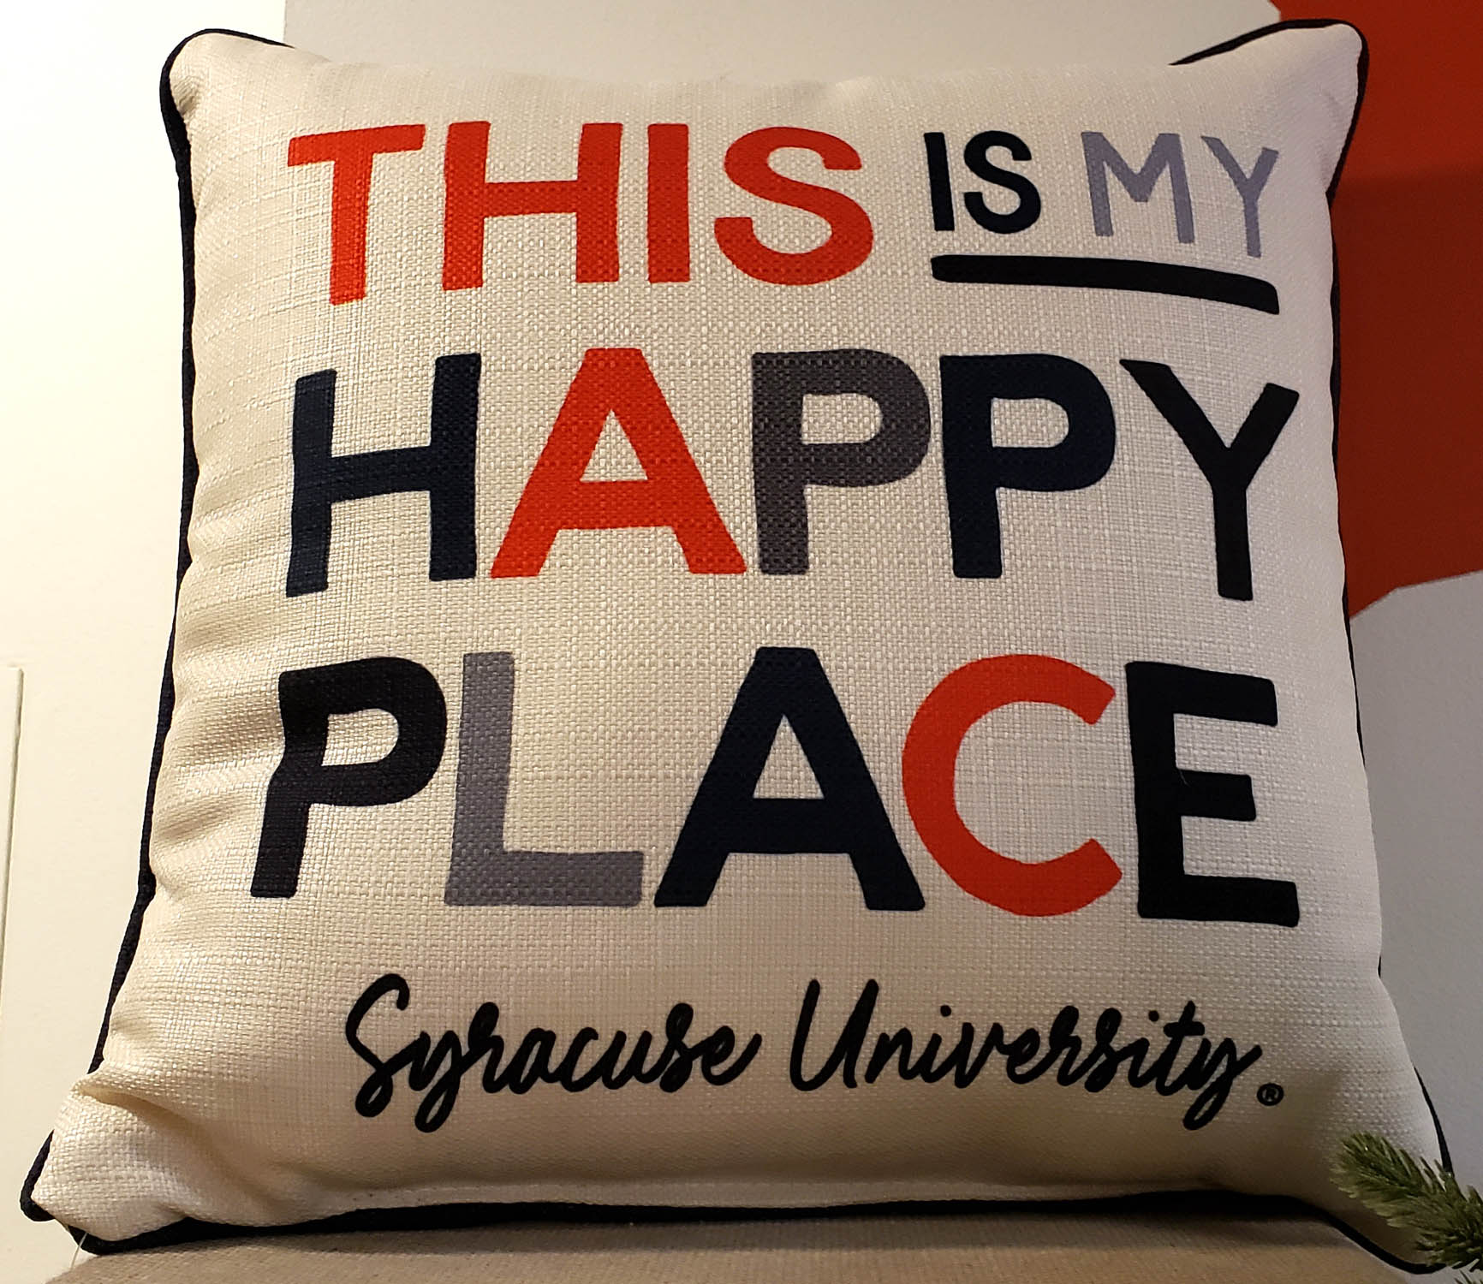
Thanks for joining us today!

